Slide 1


SkillsDomain
SkillsDomain ELECTORAL INTELLIGENCE
INFRASTRUCTURE PITCH
Transforming Political Strategy Through
Data-Driven Electoral Management
DATA ANALYTICS COMPANY
Strategic Briefing | 2026

Slide 2

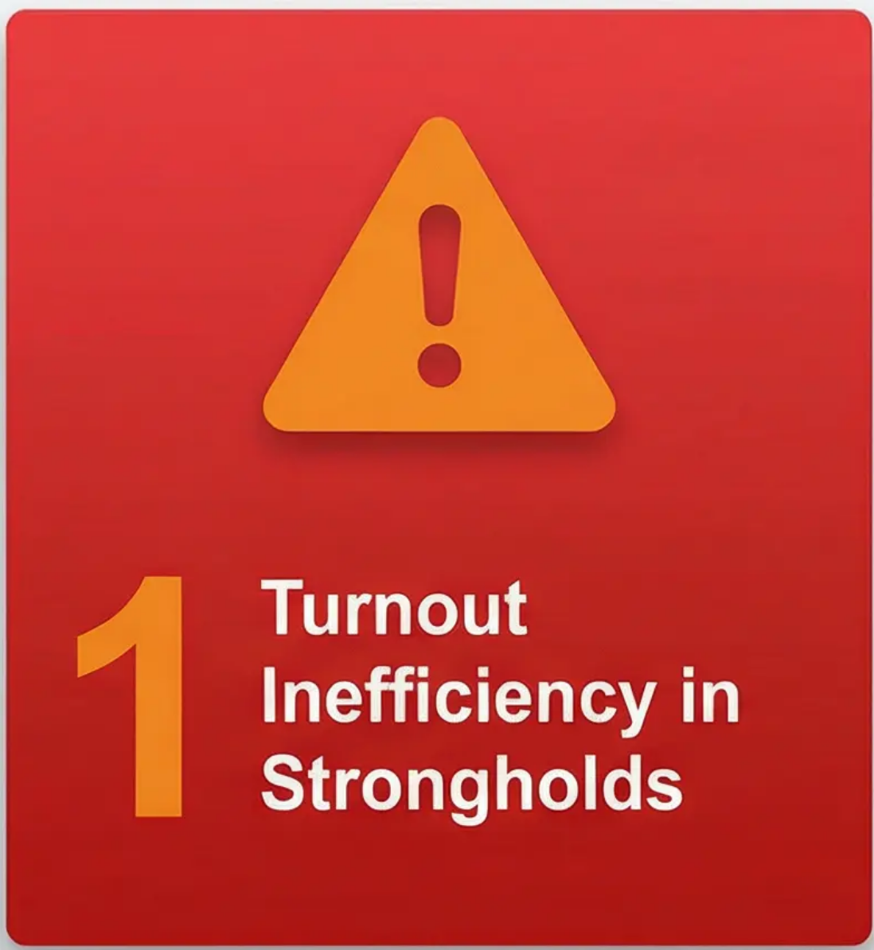
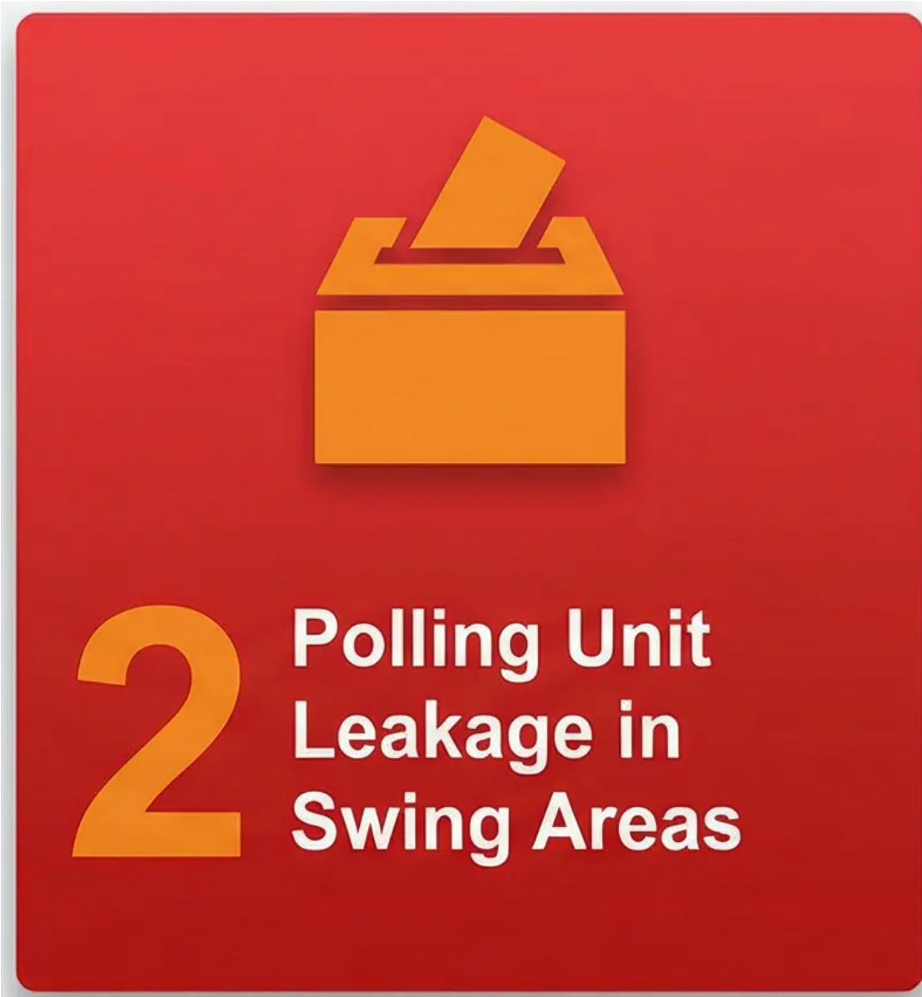
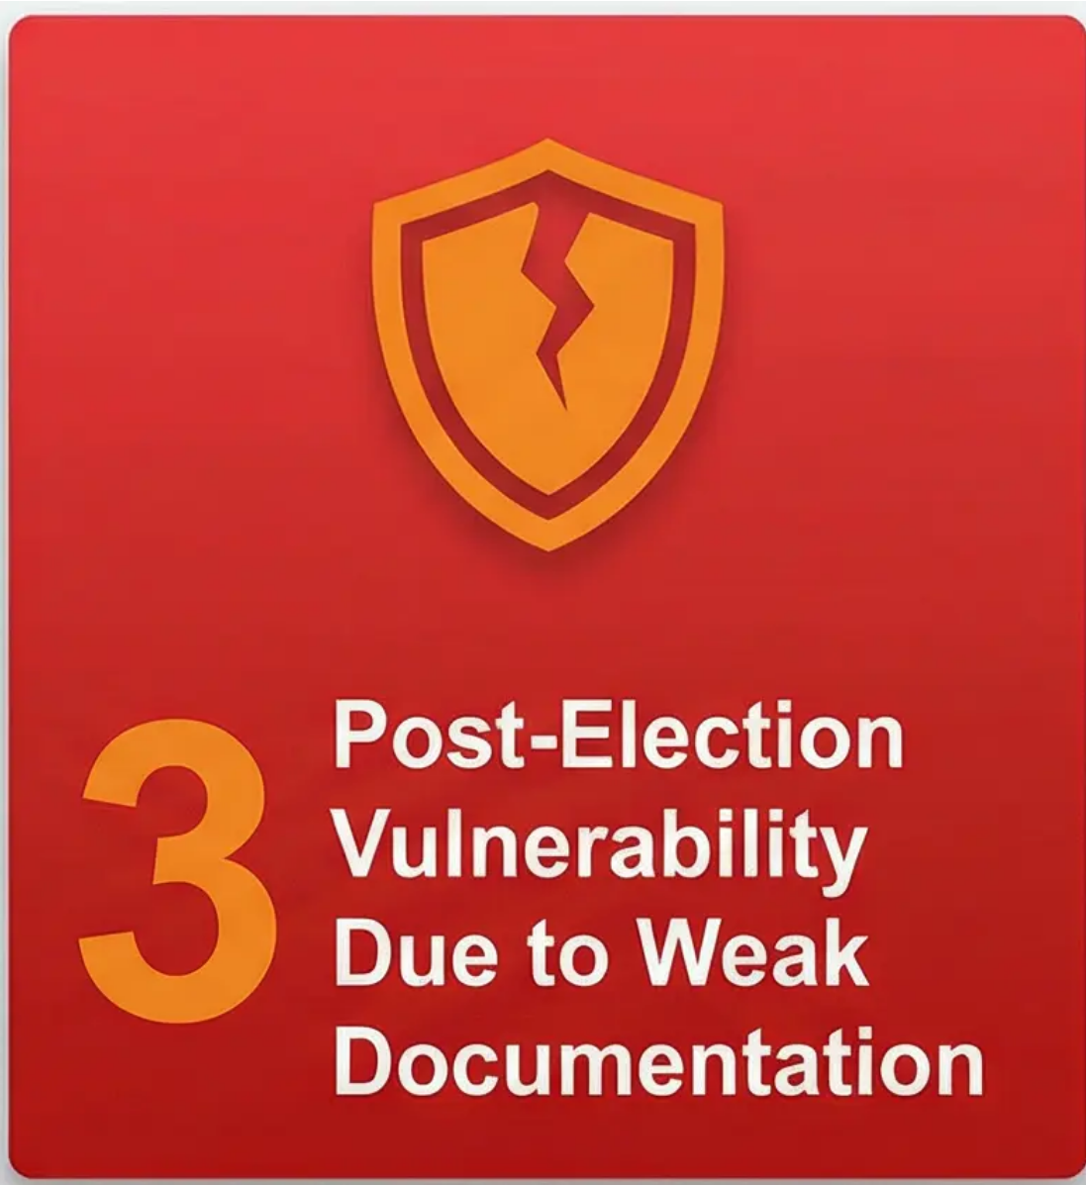
The Three Hidden Risks in Modern Elections
The Risks Most Campaigns Discover Too Late
DATA ANALYTICS COMPANY
Most campaigns detect these weaknesses after results are declared.
Electoral Intelligence Infrastructure

Slide 3

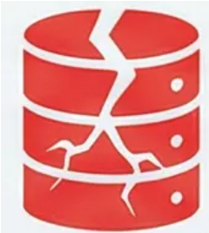




The Intelligence Gap
What Most Political Structures Lack
No unified voter data ingestion system
No turnout probability modelling
No live accreditation anomaly detection
No pre-built tribunal evidence archive
DATA ANALYTICS COMPANY
Strategy without infrastructure is vulnerability.
Electoral Intelligence Infrastructure

Slide 4

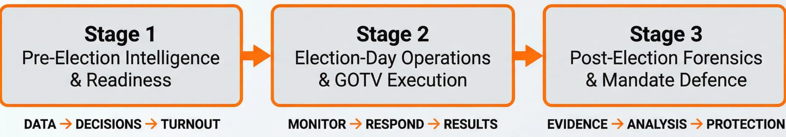
Introducing Electoral Intelligence Infrastructure (EII™)
Control the Pipeline. Control the Mandate.
SkillsDomain™ Integrated Electoral Management Methodology Lifecycle
SkillsDomain™
We control the full electoral intelligence pipeline.
Electoral Intelligence Infrastructure

Slide 5

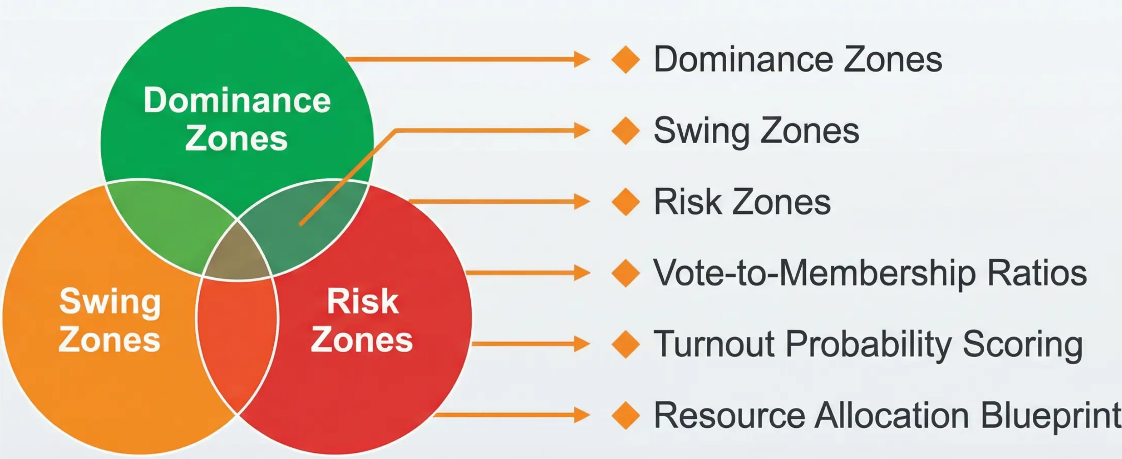
Phase I: Pre-Election Strategic Control
Know Your Map Before You Enter the Field
This prevents wasted billions in blind mobilization.
DATA ANALYTICS COMPANY
Electoral Intelligence Infrastructure

Slide 6

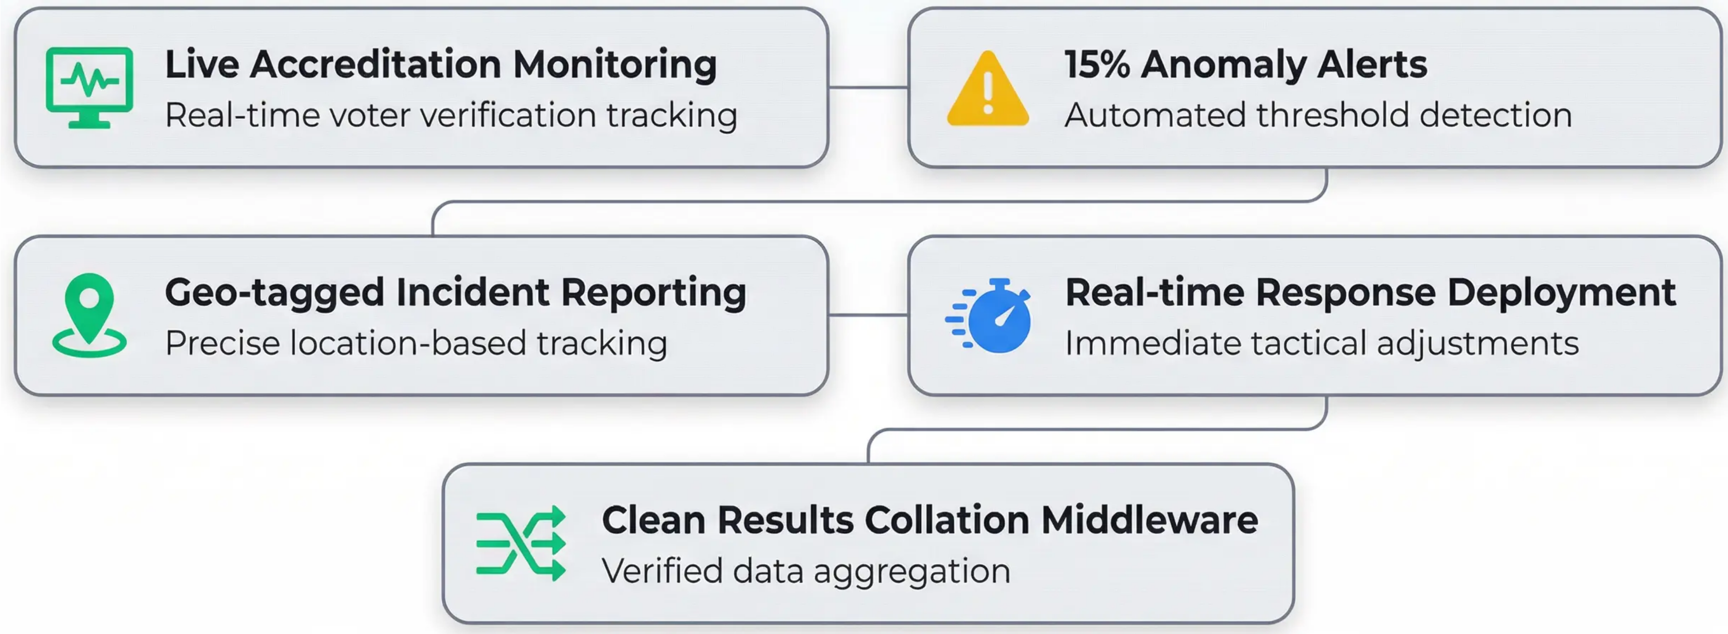
Phase II: Election-Day Command & Control
From Chaos to Command
DATA ANALYTICS COMPANY
Election day becomes controlled execution, not reactive management.
Electoral Intelligence Infrastructure

Slide 7





Phase III: Mandate Protection & Tribunal Readiness
Prepare Defence Before the Attack
EC8A / EC8B Cross-Verification
Results form validation and integrity checks
BVAS Matching
Biometric verification alignment
Statistical Anomaly Reporting
Data pattern irregularity detection
Version-Controlled Archival System
Forensic evidence preservation
We do not scramble after results. We build defensibility from day one.
DATA ANALYTICS COMPANY
Electoral Intelligence Infrastructure

Slide 8
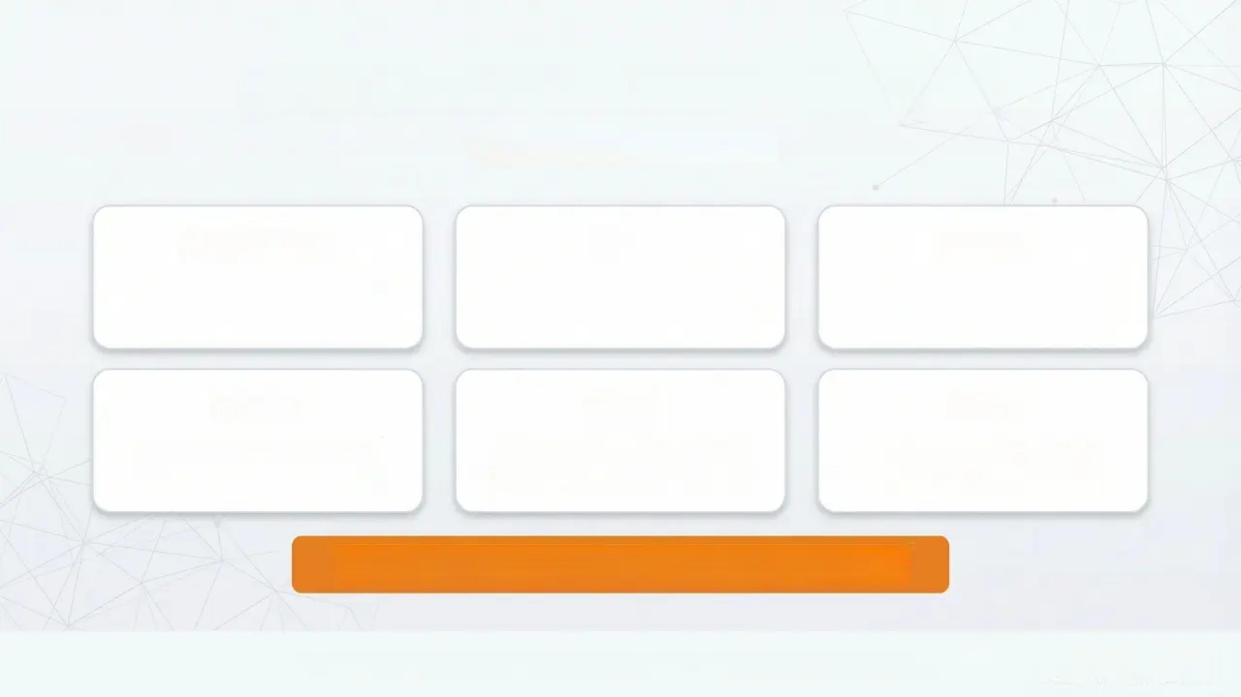
Proven Deployment Capacity
Operational at Scale
Anambra
Oyo
Ondo
5,720 PUs
4,783 PUs
3,009 PUs
Osun
Kogi
Ekiti
3,010 PUs
2,548 PUs
2,195 PUs
Total Polling Units Managed: 21,265
We are not theoretical. We have executed at scale.
DATA ANALYTICS COMPANY
Electoral Intelligence Infrastructure

Slide 9







Strategic Advantage
What This Means for You
Reduced Risk Exposure
Swing Zone Precision
Optimized Campaign
Resource Deployment
Election-Day Control
Stronghold Protection
Mandate Defensibility
This is not an expense. It is political risk mitigation.
DATA ANALYTICS COMPANY
Electoral Intelligence Infrastructure

Slide 10

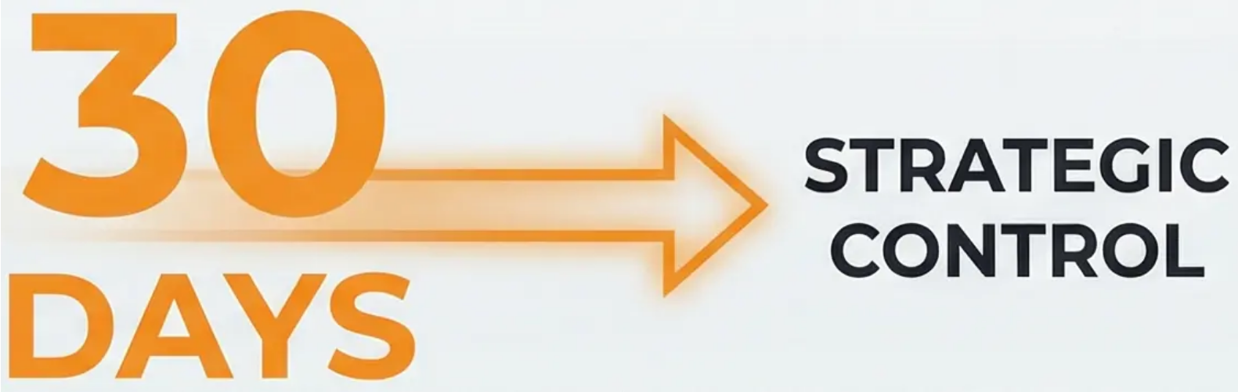
The Strategic Next Step
Begin With Confidential Intelligence Diagnostic
PROPOSE:
• 30-day confidential state-level assessment
• PU-level turnout & risk heatmap
• Vulnerability identification
• Infrastructure readiness plan
The question is not whether this is useful. The question is whether you
want to control your intelligence early.
Contact for Confidential Consultation
DATA ANALYTICS COMPANY
Electoral Intelligence Infrastructure

